Slide 1
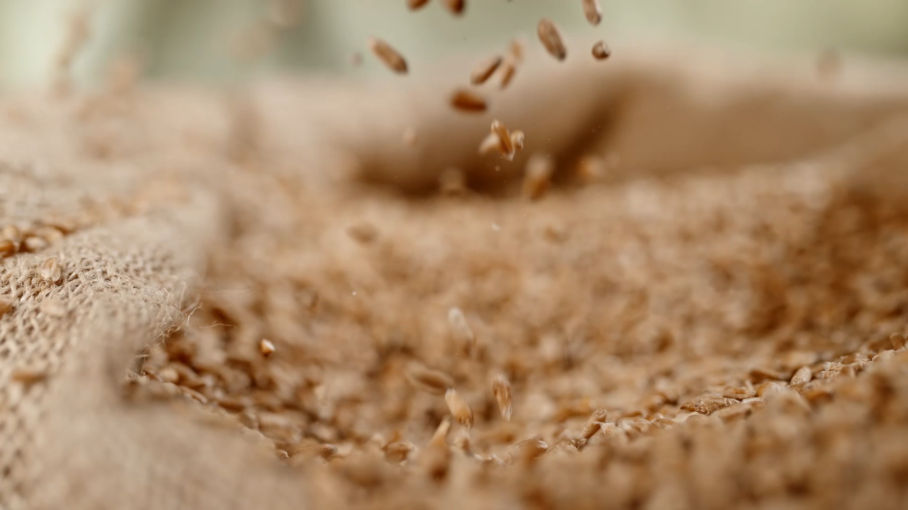
Prediction of Nitrogen Fertilizer Based on Crop
CIS 890
Introduction To Food Informatics
Aryan Singh Dalal
Dr. Hande McGinty

Slide 2

Indexing
Introduction
Data collection
Data Processing
Model Comparison
User Interface

Slide 3
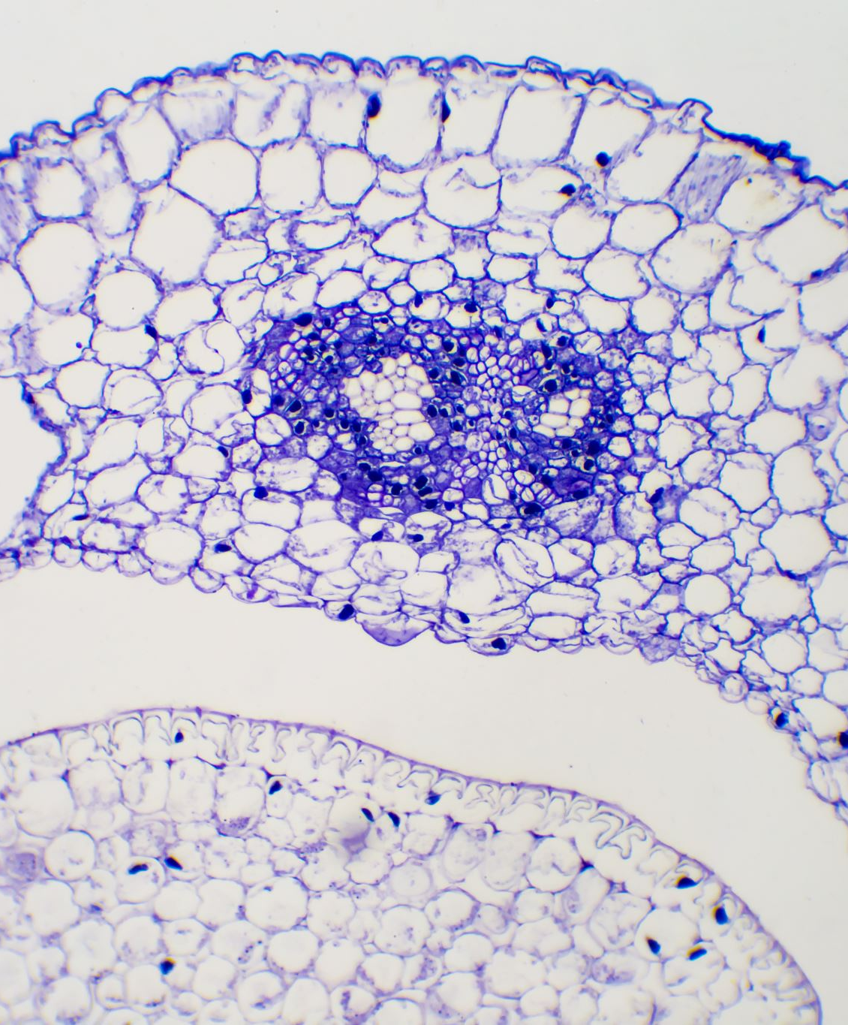
The More The Better
Essential Building Block
Photosynthesis Facilitator
Protein and DNA Formation
Plant Structure and Function:

Slide 4

Surprise!
Root and Foliage Damage
Vulnerability to Pests and Diseases
Environmental Impact
Nitrogen Leaching

Slide 5
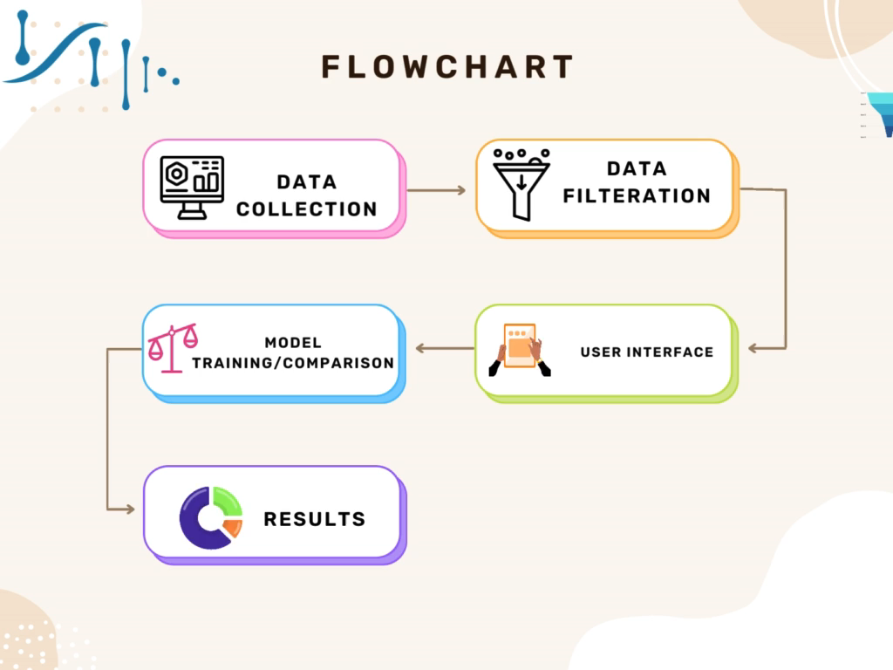
Process

Slide 6
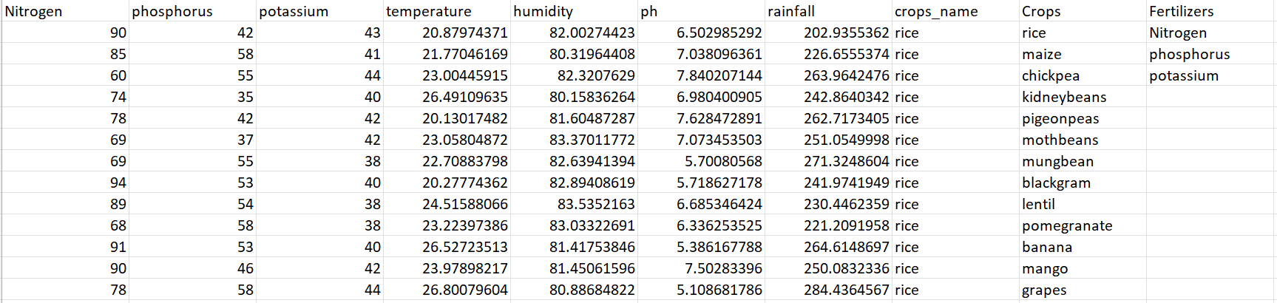
Data Collection
Open Source Data Library: Kaggle
Consideration: Related parameters to plantation

Slide 7

Data Filtration
No units were present, had to assume SI Units
Redundancy had to be removed
US Metric System

Slide 8

MODELS
Linear Regression

Slide 9
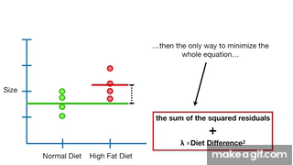
Models Ridge Regression

Slide 10
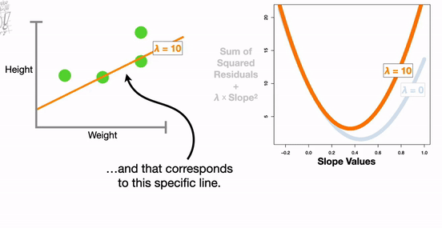
Models Lasso Regression

Slide 11
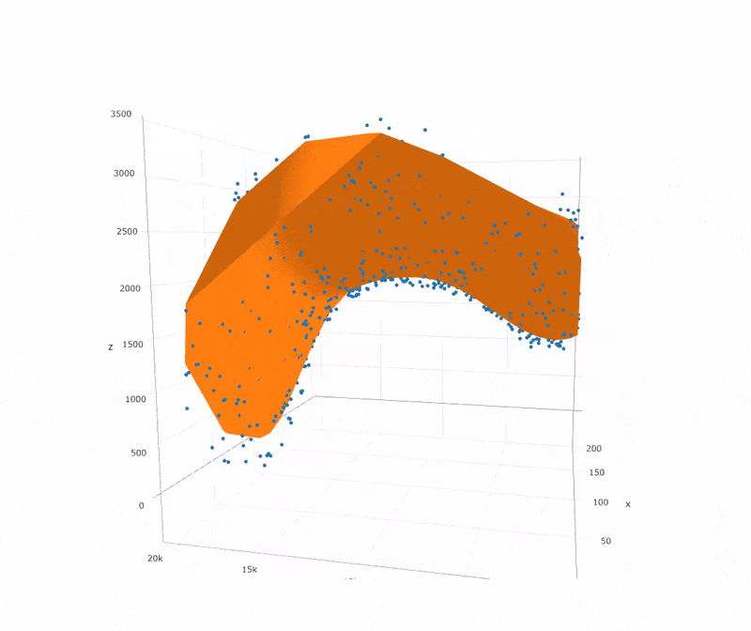
Models SVR

Slide 12
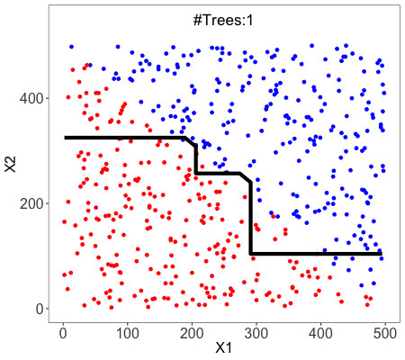
Models Random Forest REgression

Slide 13
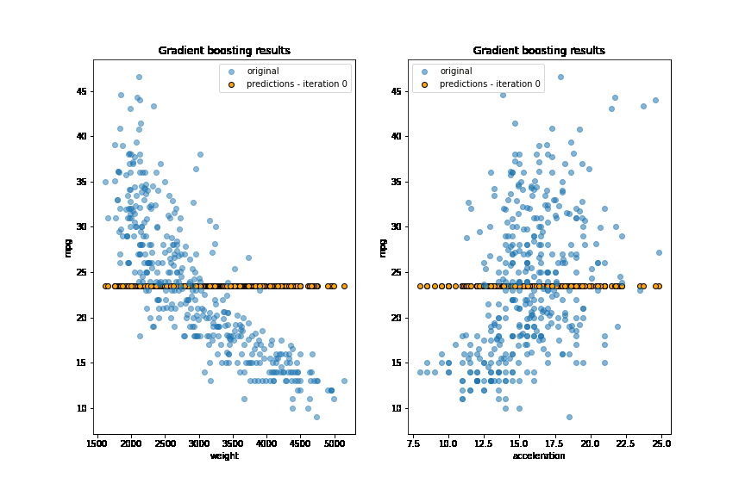
Models Gradient Boosting Regression

Slide 14

Best Model
Ridge Regression with Mean Squared Error: 136.75447191661425
R-squared (R2): 0.8905621819963452

Slide 15
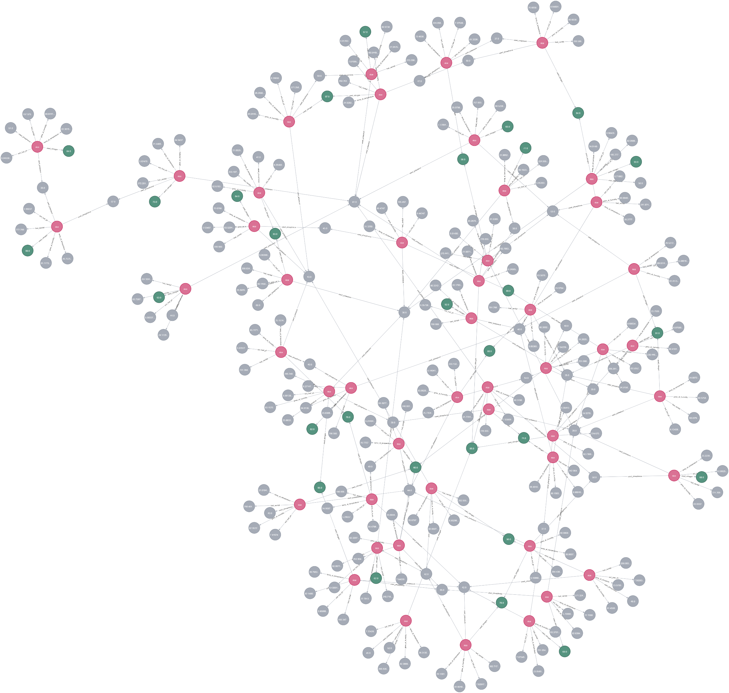
Neo4j Instance

Slide 16

User Interface
Here we go

